Slide 1
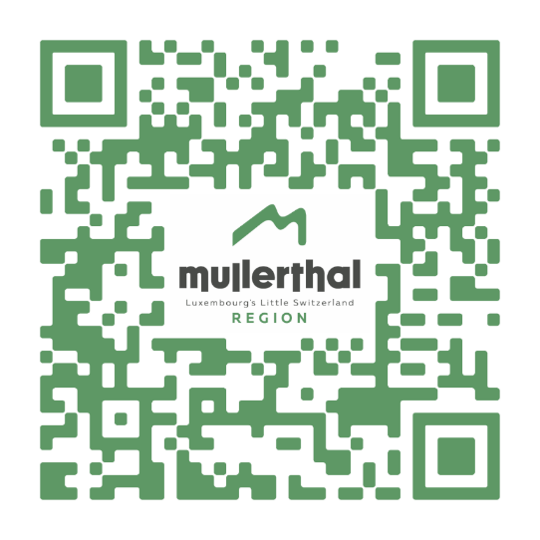
What‘s on…?
Mullerthal Region - Luxembourg‘s Little Switzerland
Discover many sports and cultural events taking place in the Mullerthal Region – Luxembourg‘s Little Switzerland!
www.mullerthal.lu
1

Slide 2
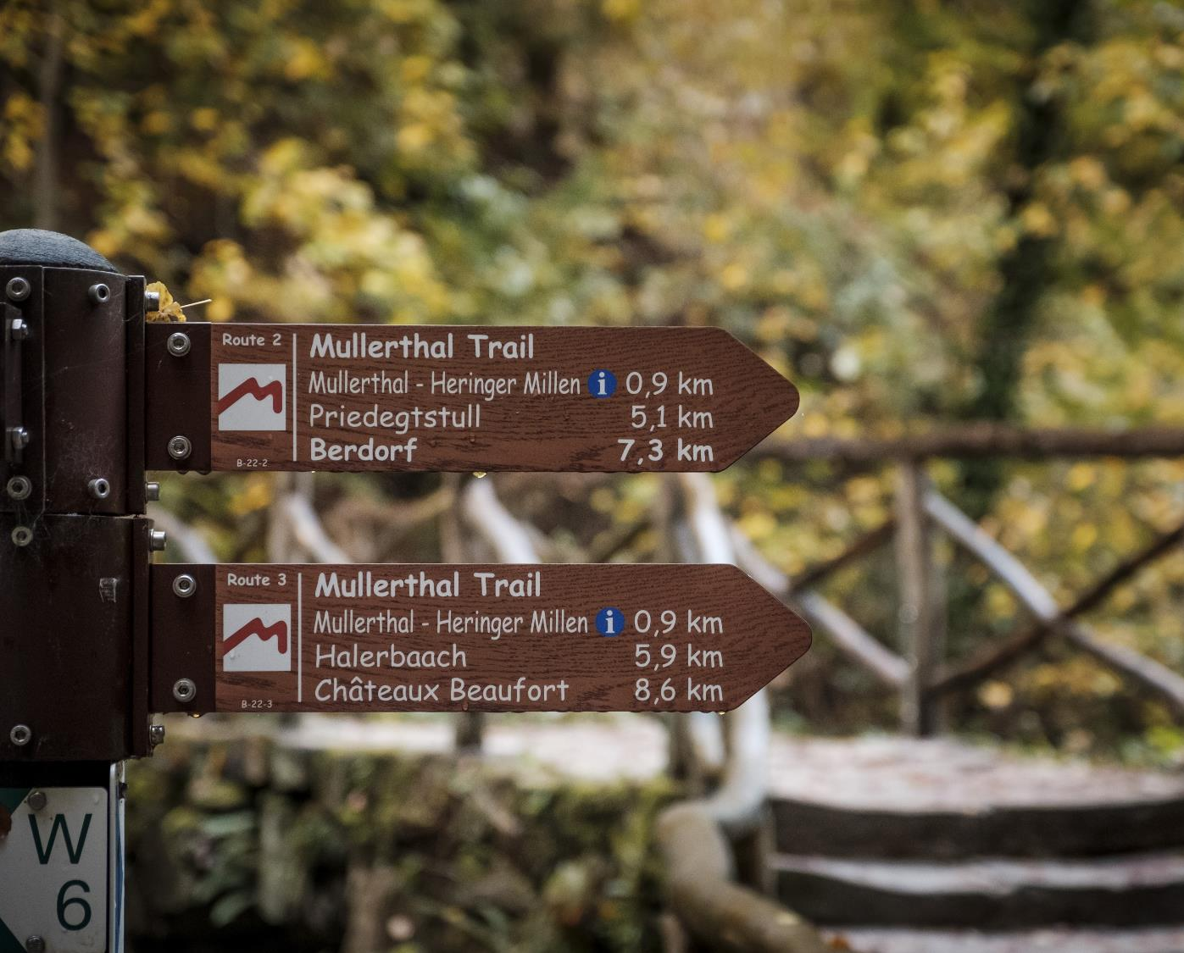
The Mullerthal Trail with its 112 km passes along the natural beauties of the Mullerthal Region!
Route 1: 36 km
Route 2: 38 km
Route 3: 38 km
www.mullerthal-trail.lu
© Pancake! Photographie

Slide 3
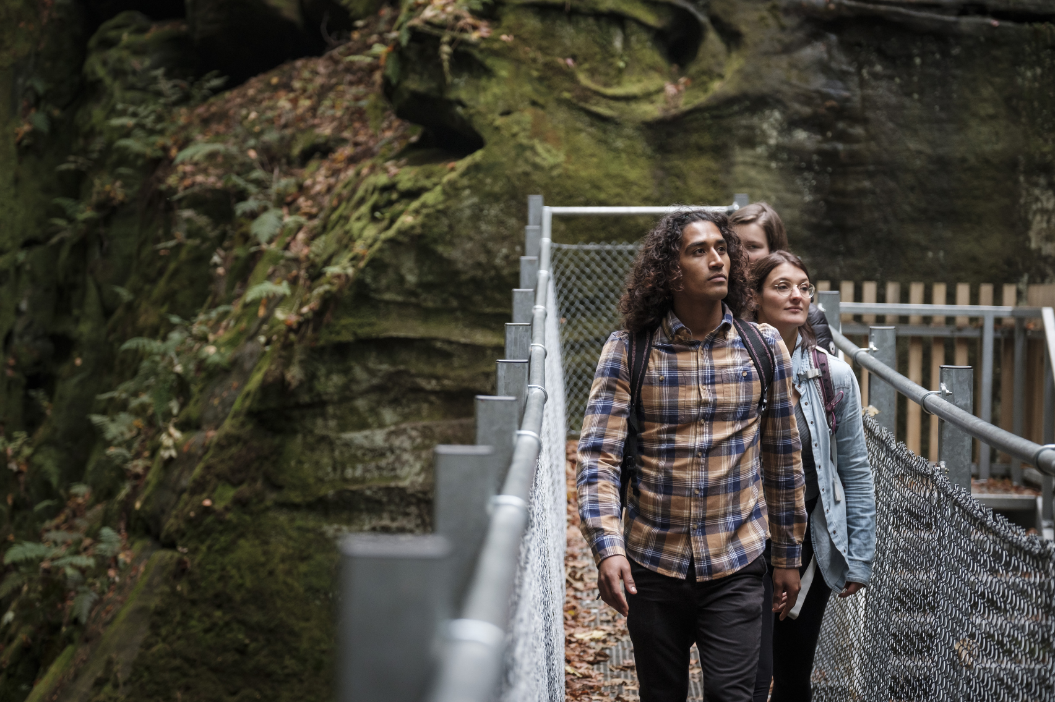
Hiking suggestion:
Local hiking path B2
Discover one of the most beautiful walks of the Mullerthal Region.
Starting point: Tourist Info / Camping Martbusch in Berdorf
Length: 4,2 km
Time: 2 h
Difficulty: average
www.mullerthal.lu
© Pancake! Photographie

Slide 4
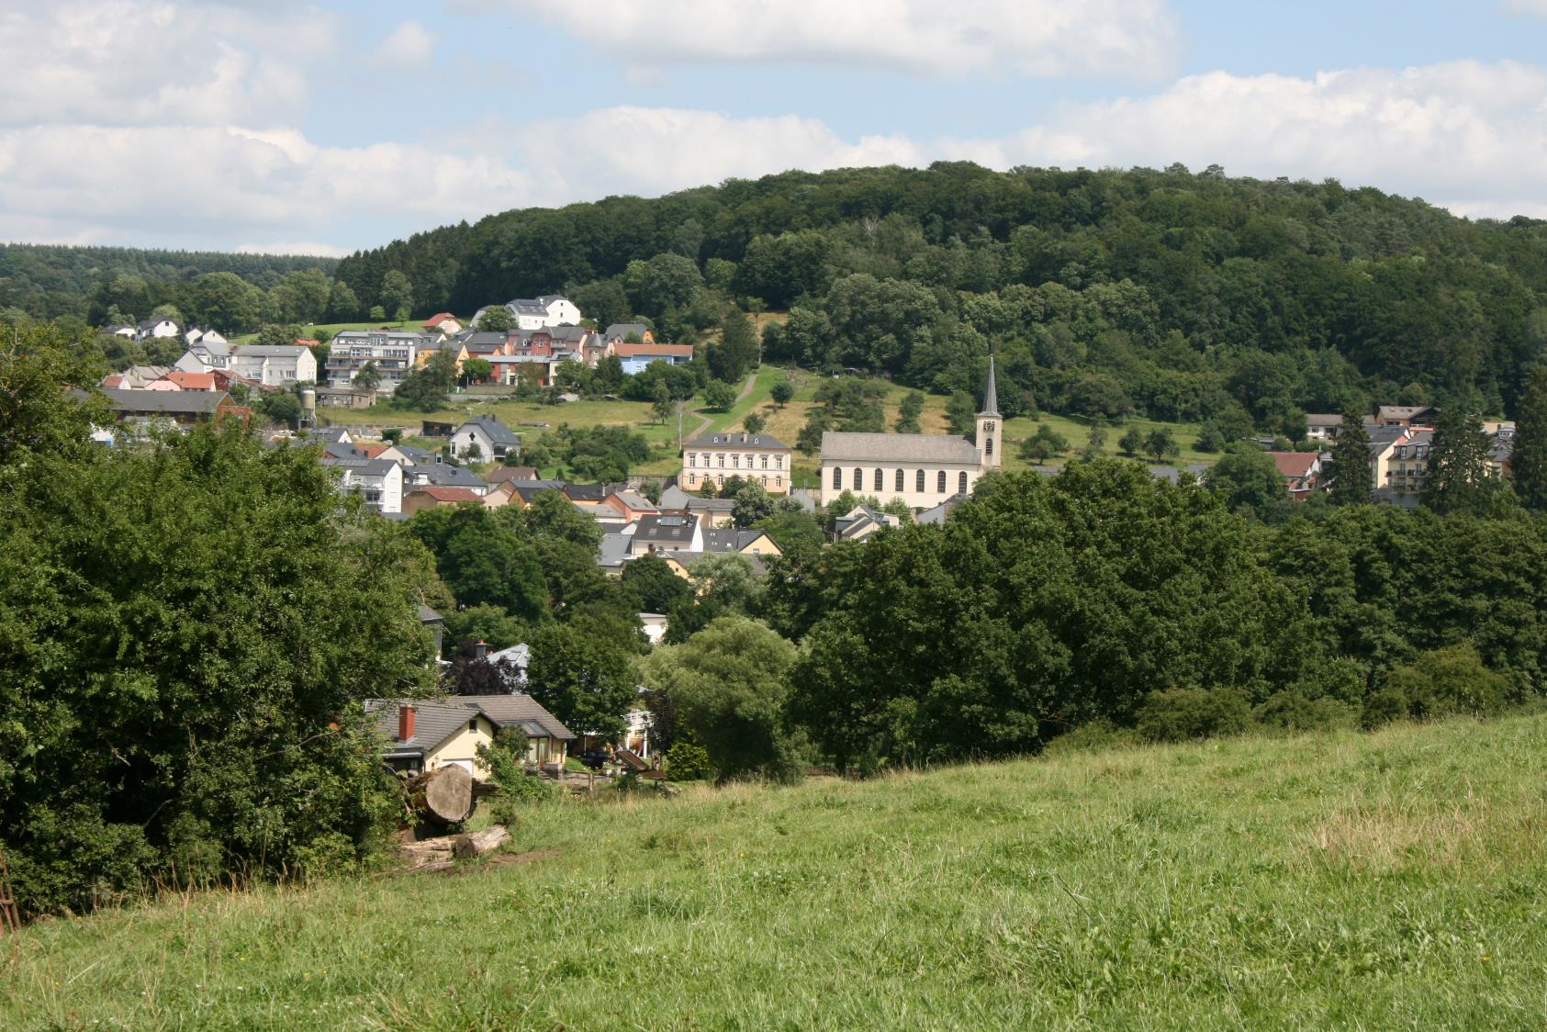
Hiking suggestion:
Local hiking trail M4
This varied circular tour offers great views on the castle of Larochette. You walk through forests, meadows, along the water and through the lively town of Larochette.
Starting point:
Townhall of Medernach
Length: 13,9 km
Time: 3:50 h
Difficulty: average
www.mullerthal.lu
© SIT Aerenzdallgemeng
© ORT MPSL

Slide 5
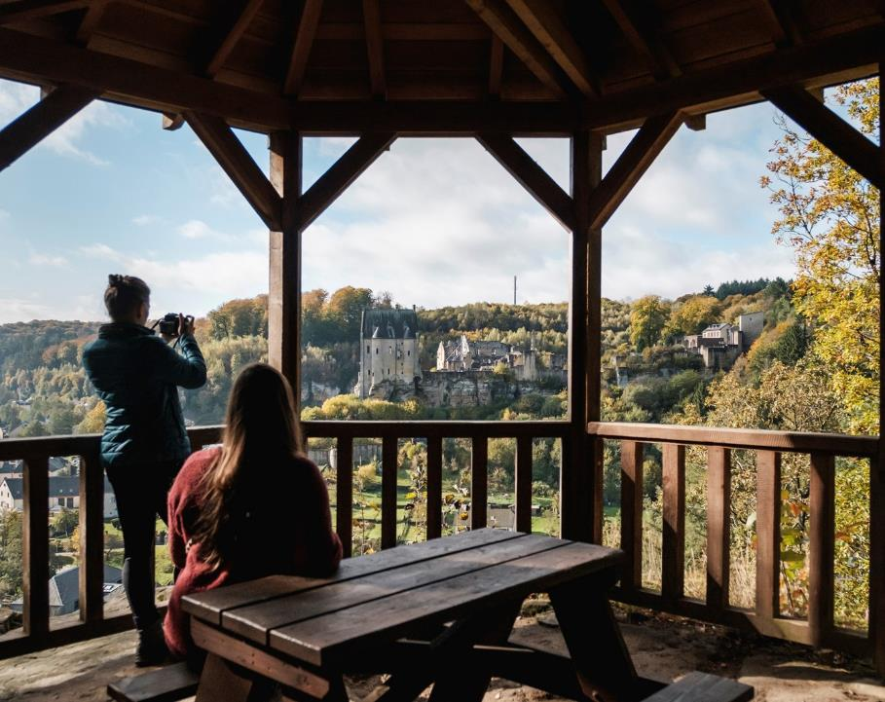
Viewpoint Salzdeebelchen
The viewpoint Salzdeebelchen offers a great view on Larochette castle.
Accessible via: Mullerthal Trail Route 3, ExtraTour A, Auto-Pédestre Larochette & local hiking trail M4
www.mullerthal.lu
© Pancake! Photographie

Slide 6
What‘s on…?
Mullerthal Region - Luxembourg‘s Little Switzerland
Discover many sports and cultural events taking place in the Mullerthal Region – Luxembourg‘s Little Switzerland!
www.mullerthal.lu
2

Slide 7
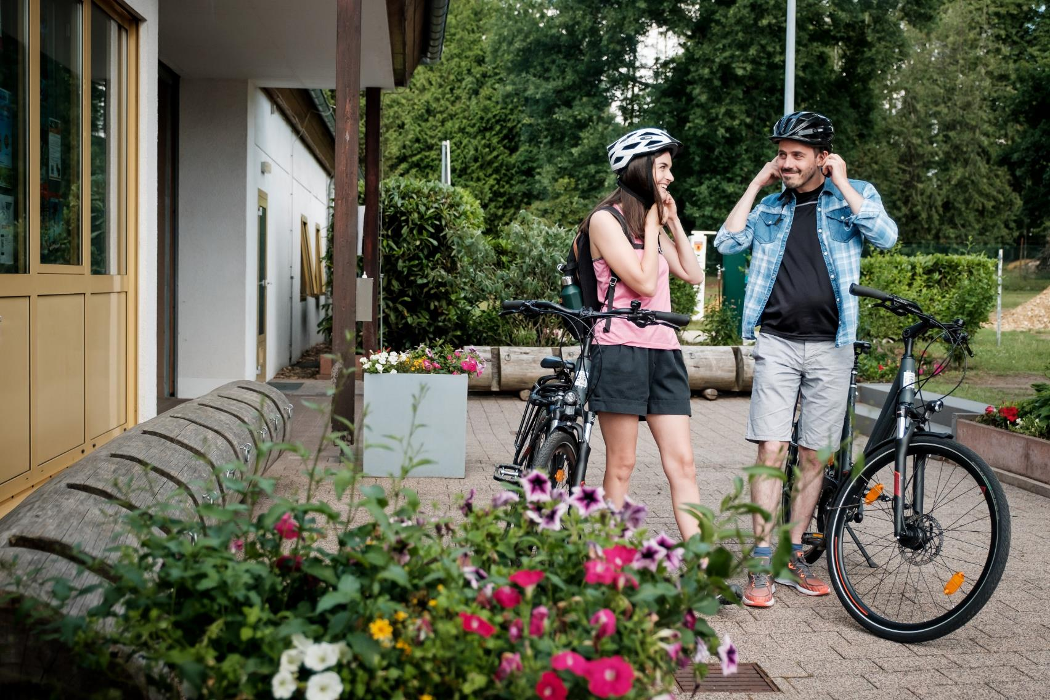
Rent a bike
Order a bike and ask to get it delivered to one of the
rental stations
www.rentabike-mellerdall.lu
© Pancake! Photographie

Slide 8
5 mountain bike trails
Rock formations, woods – get the flow while mountain biking in the Mullerthal Region.
5 signposted mountain bike trails of varying difficulty guarantee pure biking pleasure.
www.mullerthal.lu
© Sophie Margue

Slide 9
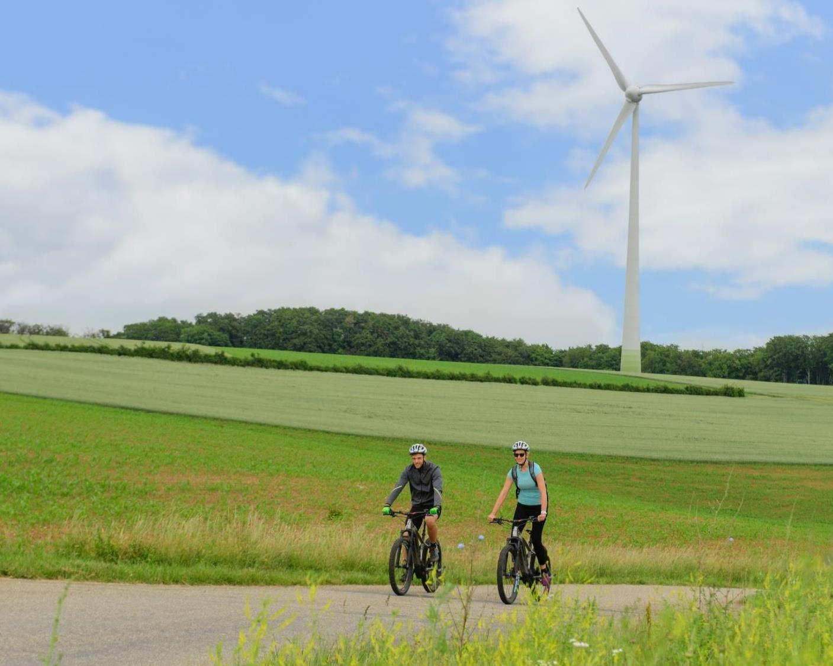
Local cycle path Tudor Tour
Explore the alternative electricity production in Luxembourg with an e-bike or a touring bike. The cycle track leads past the interactive Tudor museum, Lake Echternach, Roman Villa Echternach Sauerpark Rosport, etc.
É
www.mullerthal.lu
© Fotostudio Creativ

Slide 10
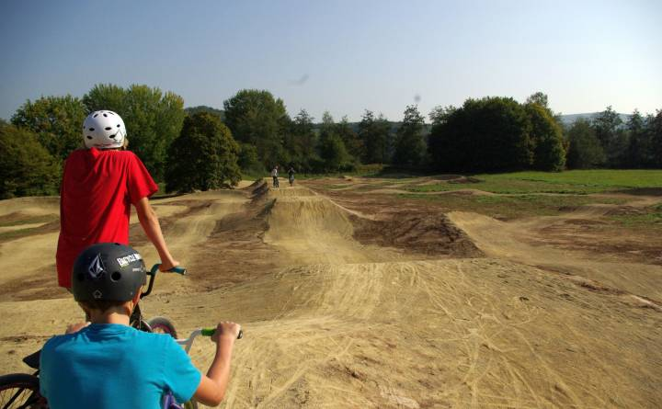
Bike Park
Discover the Bike Park along the lake of Echternach.
www.mullerthal.lu
© John Matrix

Slide 11
What‘s on…?
Mullerthal Region - Luxembourg‘s Little Switzerland
Discover many sports and cultural events taking place in the Mullerthal Region – Luxembourg‘s Little Switzerland!
www.mullerthal.lu
2

Slide 12
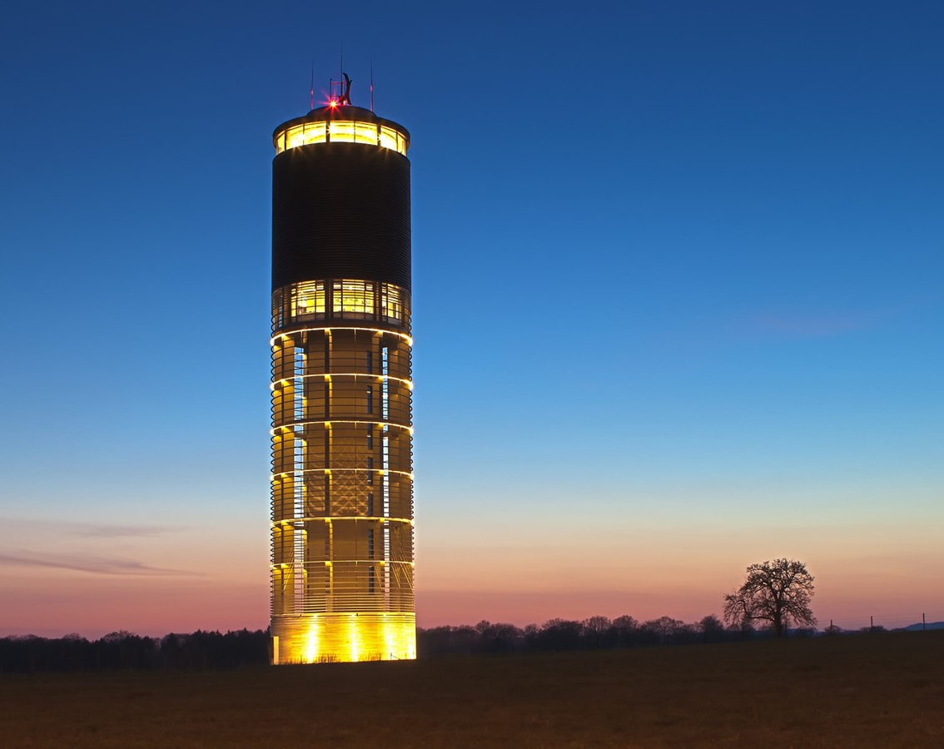
Aquatower
The Aquatower Berdorf allows you to dive into the fascinating world of water at a height of 55 meters
Opening hours:
Tuesday – Sunday: 2 PM – 6 PM
www.aquatower-berdorf.lu
© Laurent Koob

Slide 13
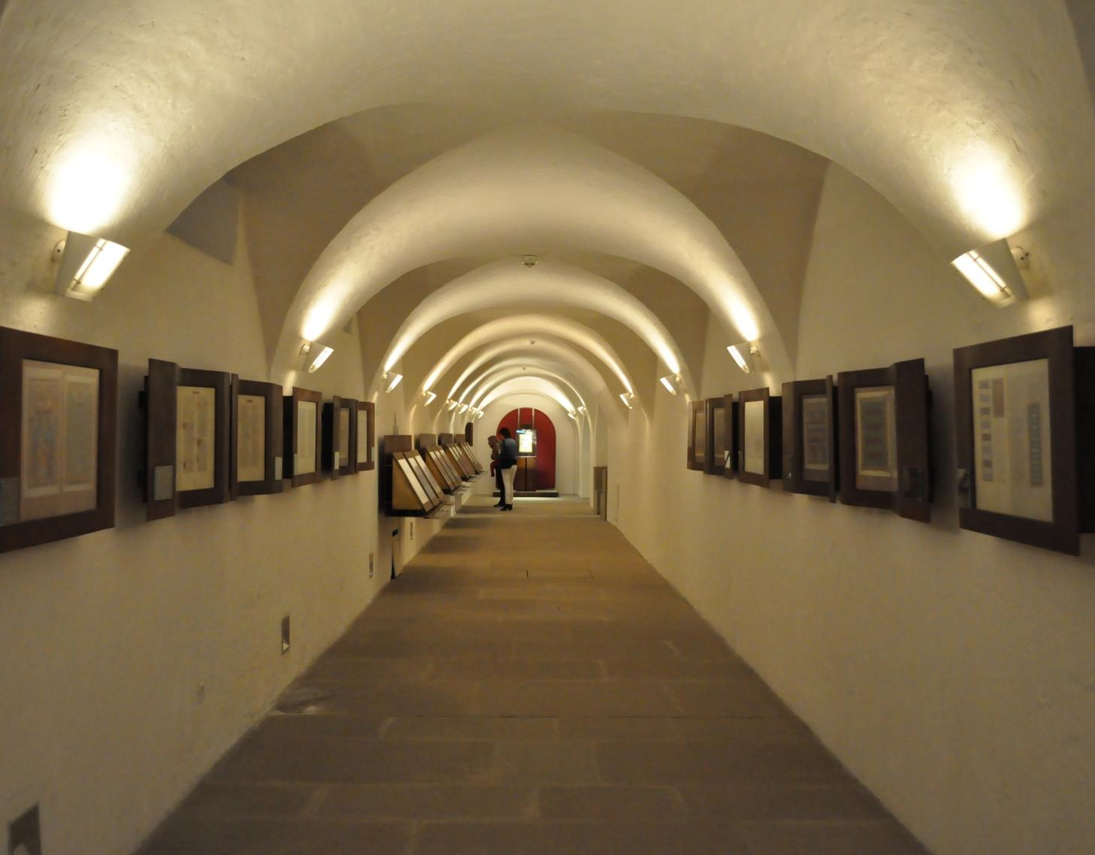
Museum of the Abbey Echternach
Admire magnificent books produced by Benedictine monks from the former abbey.
Opening hours:
Daily: 10 AM - 12 PM
2 PM – 5 PM
www.abteimuseum.org
© Stadtmarketing Echternach

Slide 14
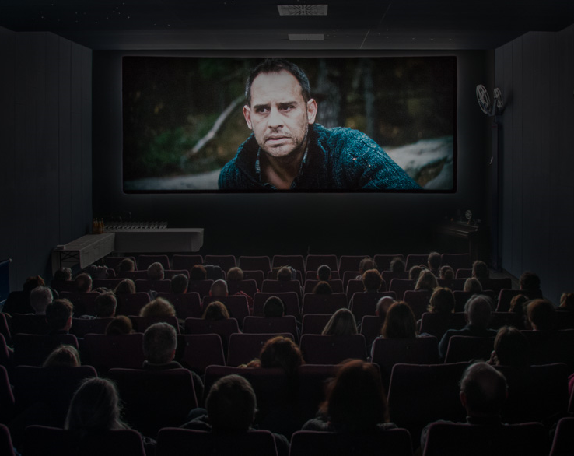
Ciné Sura
Escape the hustle and bustle of everyday life and visit the cozy cinema in Luxembourg's oldest city.
This small theater features both blockbusters and smaller productions. The program is varied.
www.cinesura.com
© Pierre Weber

Slide 15
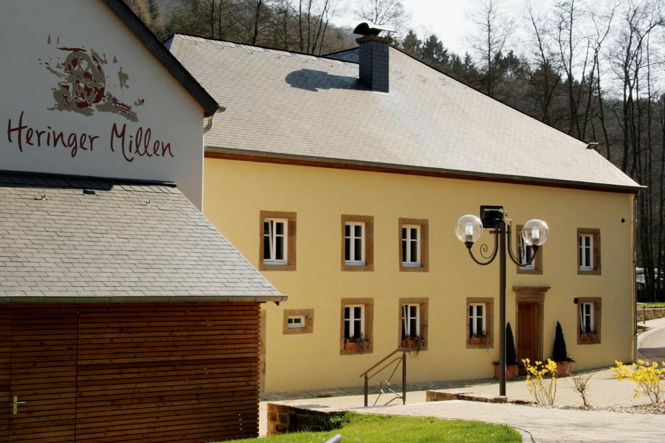
Touristcenter
Heringer Millen
Discover the restored old mill with a Tourist Information inside, where you can also buy regional products.
www.mullerthal-millen.lu
© FrameArt

Slide 16
What‘s on…?
Mullerthal Region - Luxembourg‘s Little Switzerland
Discover many sports and cultural events taking place in the Mullerthal Region – Luxembourg‘s Little Switzerland!
www.mullerthal.lu
3

Slide 17
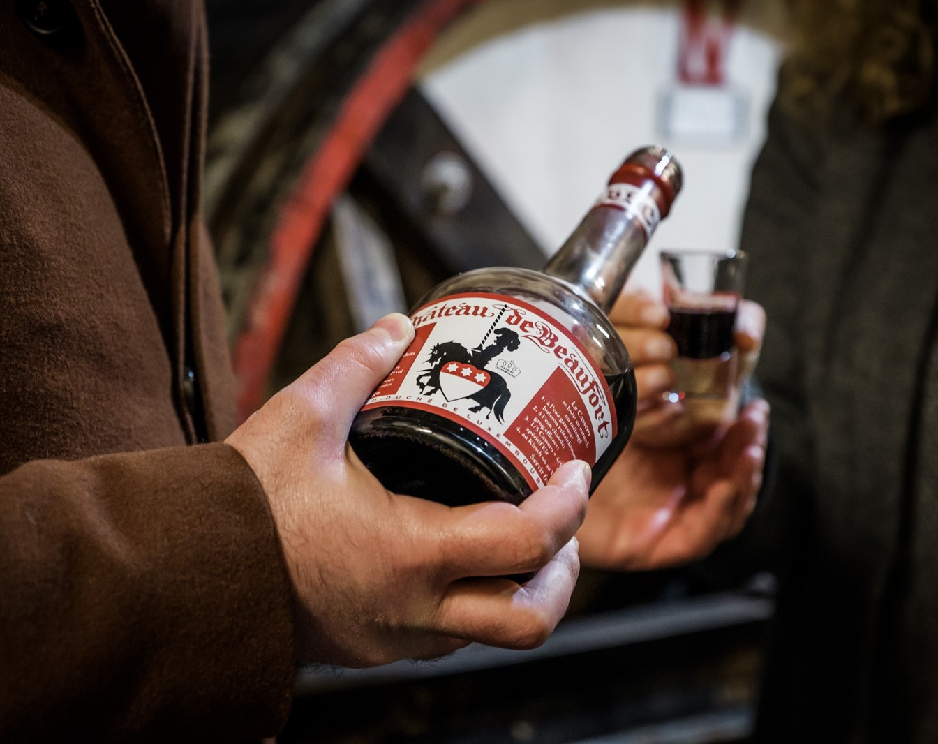
Medieval Castle Beaufort
Visit the ruins of the medieval castle in Beaufort and taste the Cassero liqueur.
Opening hours:
March 15 – November 30:
Daily from 9 AM – 6 PM
www.beaufortcastles.com
© Pancake! Photographie

Slide 18
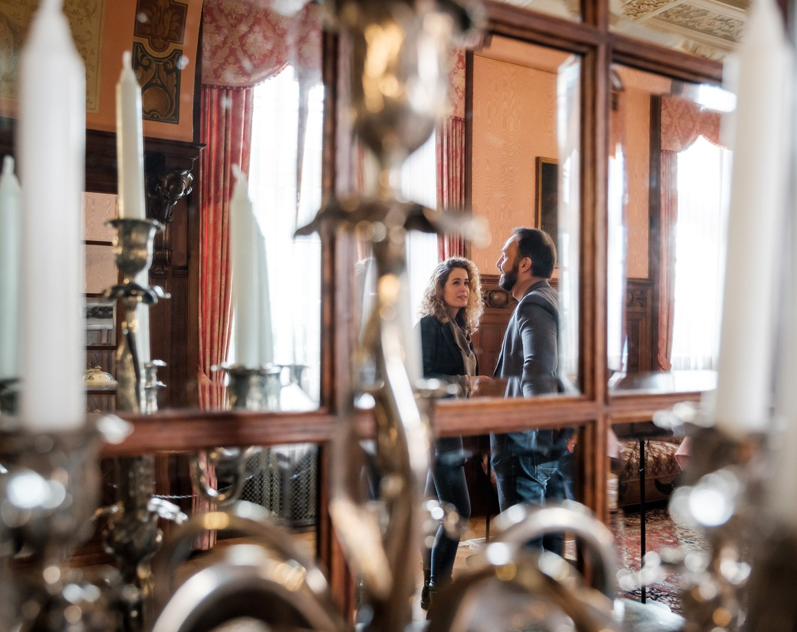
Renaissance Castle Beaufort
Visit the prestigiously furnished interiors that are maintained in the same condition as they used to be when its last owners and residents were still living in the castle.
Opening hours :
Guided tours only
Thursday - Sunday at 11 AM & 4 PM
www.beaufortcastles.com
© Pancake! Photographie

Slide 19
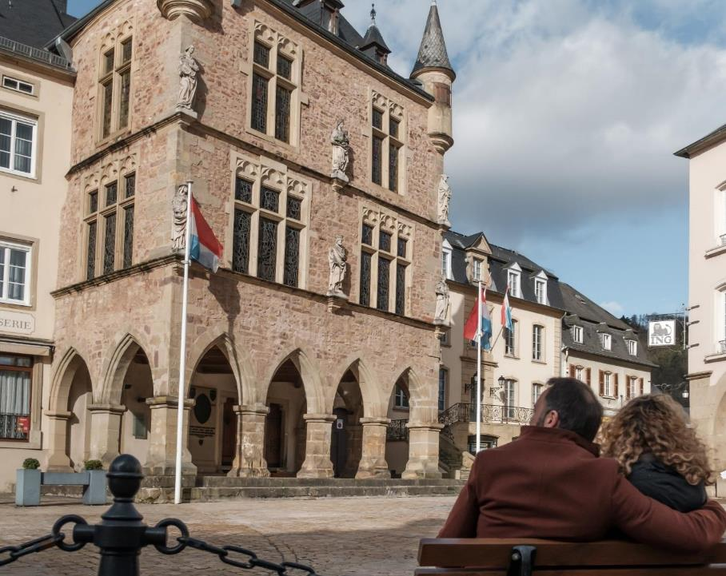
Old city of Echternach
Visit the oldest city of Luxembourg and discover the labyrinthine streets, the municipal park with the Rococo Pavilion, the Basilica and the former abbey.
www.visitechternach.lu
© Pancake! Photographie

Slide 20
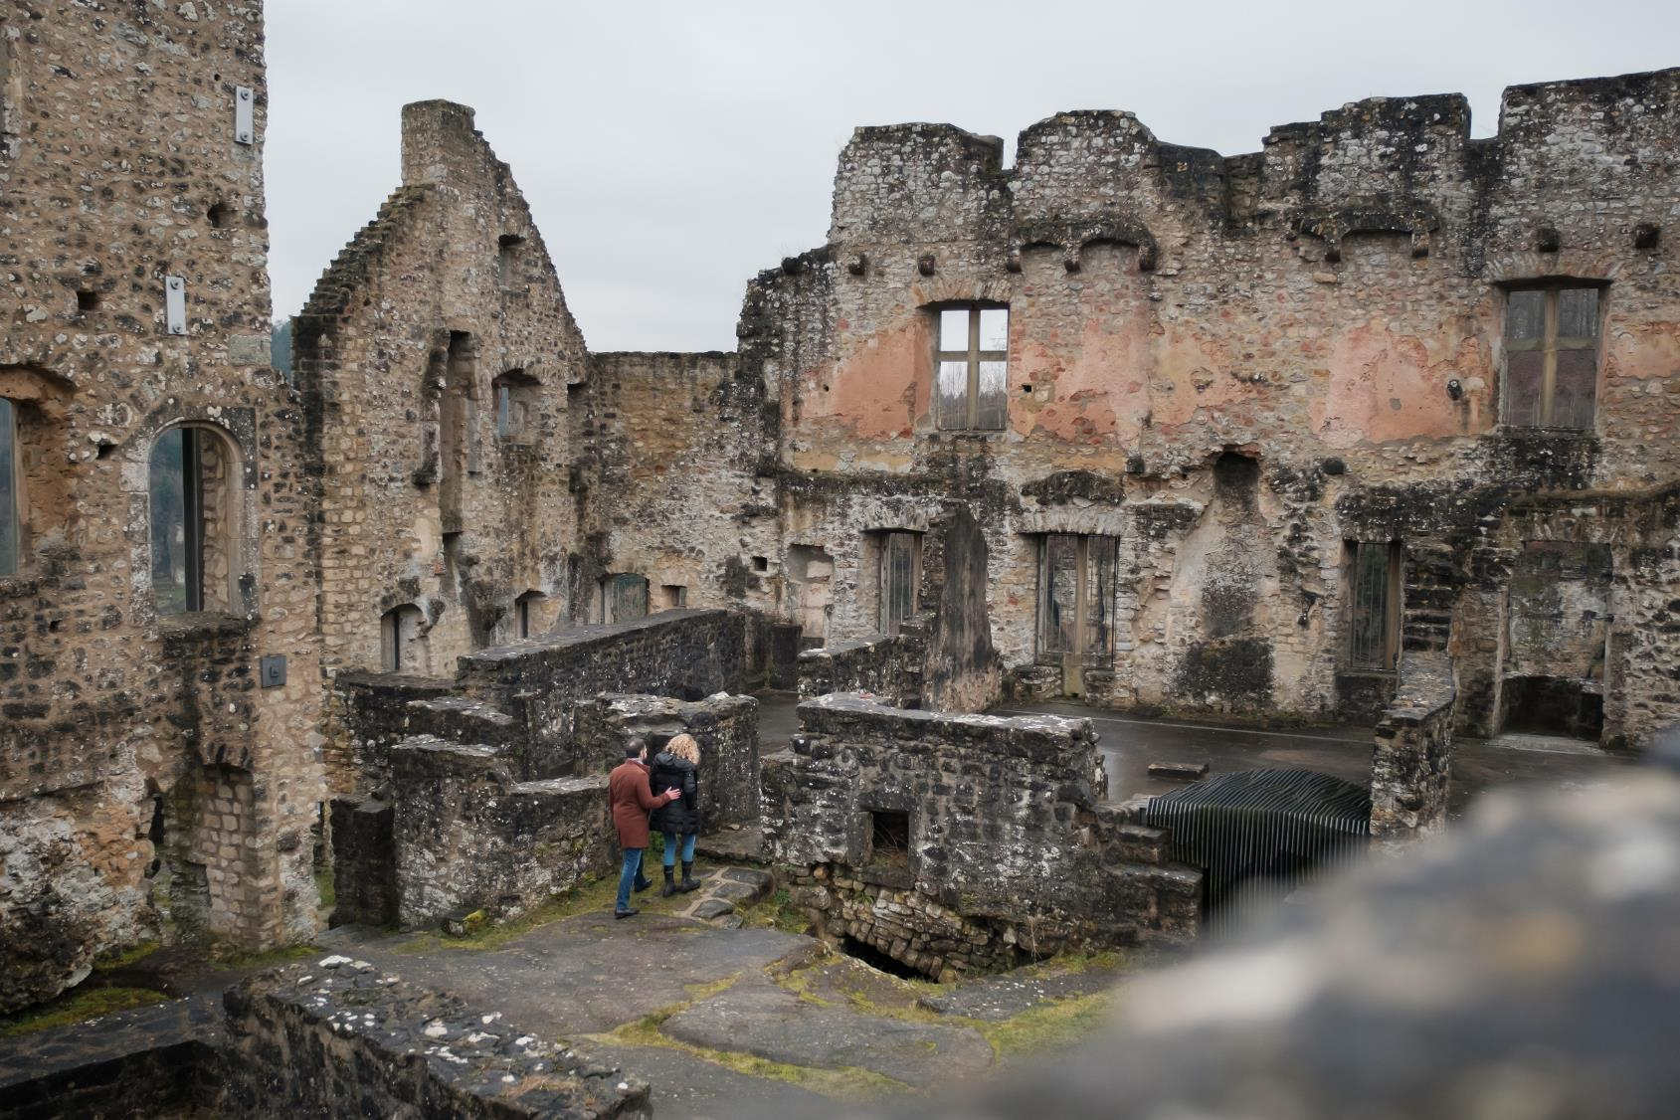
Larochette Castle
The ruins of Larochette castle are located on a sandstone promontory,
50m above the valley of the White Ernz, a tributary of the river Sûre.
Opening hours:
Daily from 9 AM – 6 PM
www.chateaularochette.lu
© Pancake! Photographie

Slide 21
What‘s on…?
Mullerthal Region - Luxembourg‘s Little Switzerland
Discover many sports and cultural events taking place in the Mullerthal Region – Luxembourg‘s Little Switzerland!
www.mullerthal.lu
5

Slide 22
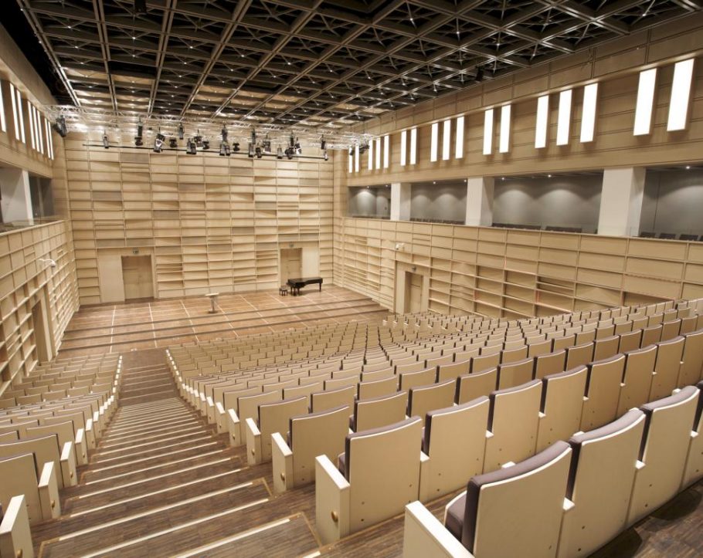
Trifolion Echternach
The Trifolion in Echternach offers a variety of cultural events such as concerts, theater, comedy and much more
www.trifolion.lu
© Wehking, Pfadpfinder

Slide 23
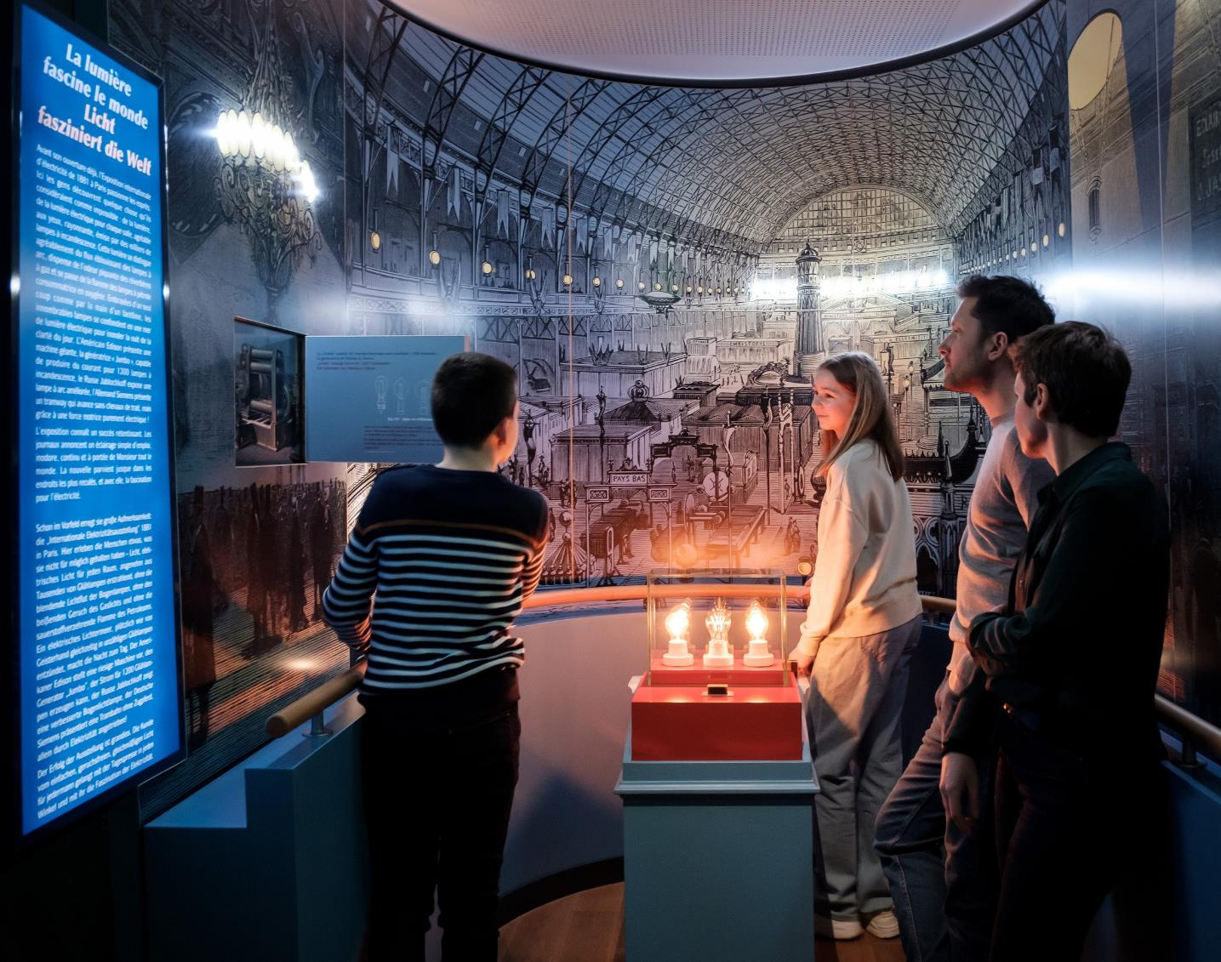
Tudor Museum
The Tudor Museum in Rosport is a mix of interactive stations and a traditional museum.
Beispieltext:
Roll-Ups, der Werbetechnik-Klassiker schlechthin
Displays und Roll-Ups lassen sich an nahezu jedem Ort als optimalen Blickfang positionieren – in direkter Blickrichtung von Messebesuchern und Passanten.
Opening hours:
Wed.-Sun.: 2 PM – 6 PM
www.musee-tudor.lu
© Pancake! Photographie
© Pancake! Photographie

Slide 24
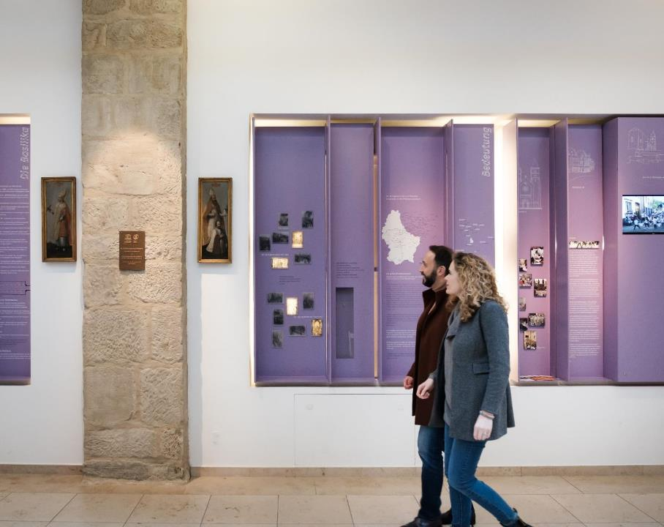
Documentation Center about the Hopping Procession
Immerse yourself in the history of the Echternach Hopping Procession and the history of the Basilica.
Opening hours: Daily: 10 AM – 12 PM
&
2 PM – 5 PM
www.mullerthal.lu
© Pancake! Photographie

Slide 25
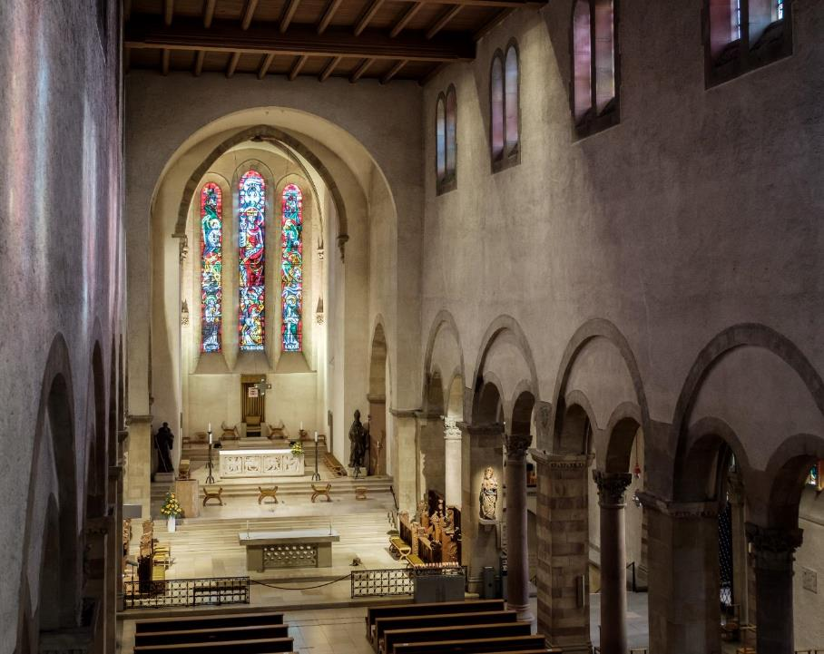
St. Willibrord Basilica Echternach
The impressive Willibrord Basilica is considered the most important religious monument in the country.
Opening hours:
daily: 8 AM – 6 PM
Sundays & holiday: from 1 PM
www.basilika.lu
© Pancake! Photographie

Slide 26
What‘s on…?
Mullerthal Region - Luxembourg‘s Little Switzerland
Discover many sports and cultural events taking place in the Mullerthal Region – Luxembourg‘s Little Switzerland!
www.mullerthal.lu
5

Slide 27
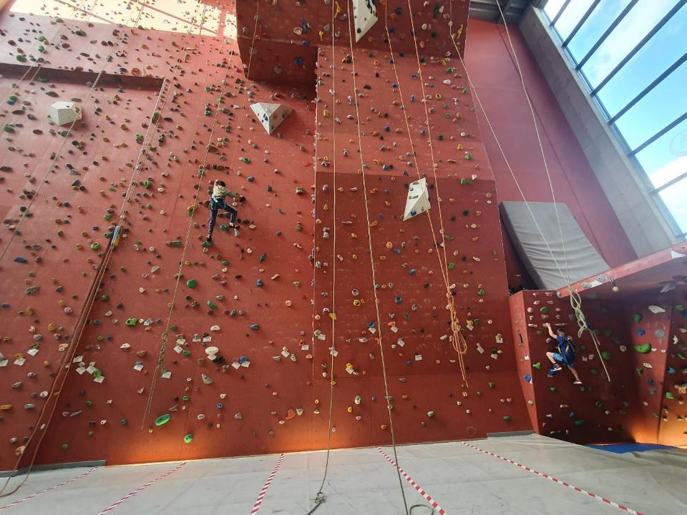
Indoor climbing in Echternach
The youth hostel at the lake of Echternach has a 14-meter-high indoor climbing wall and a bouldering area.
Opening hours on
▼
www.youthhostels.lu
© Pancake! Photographie
© Les Auberges de Jeunesse Luxembourgeoises asbl.

Slide 28
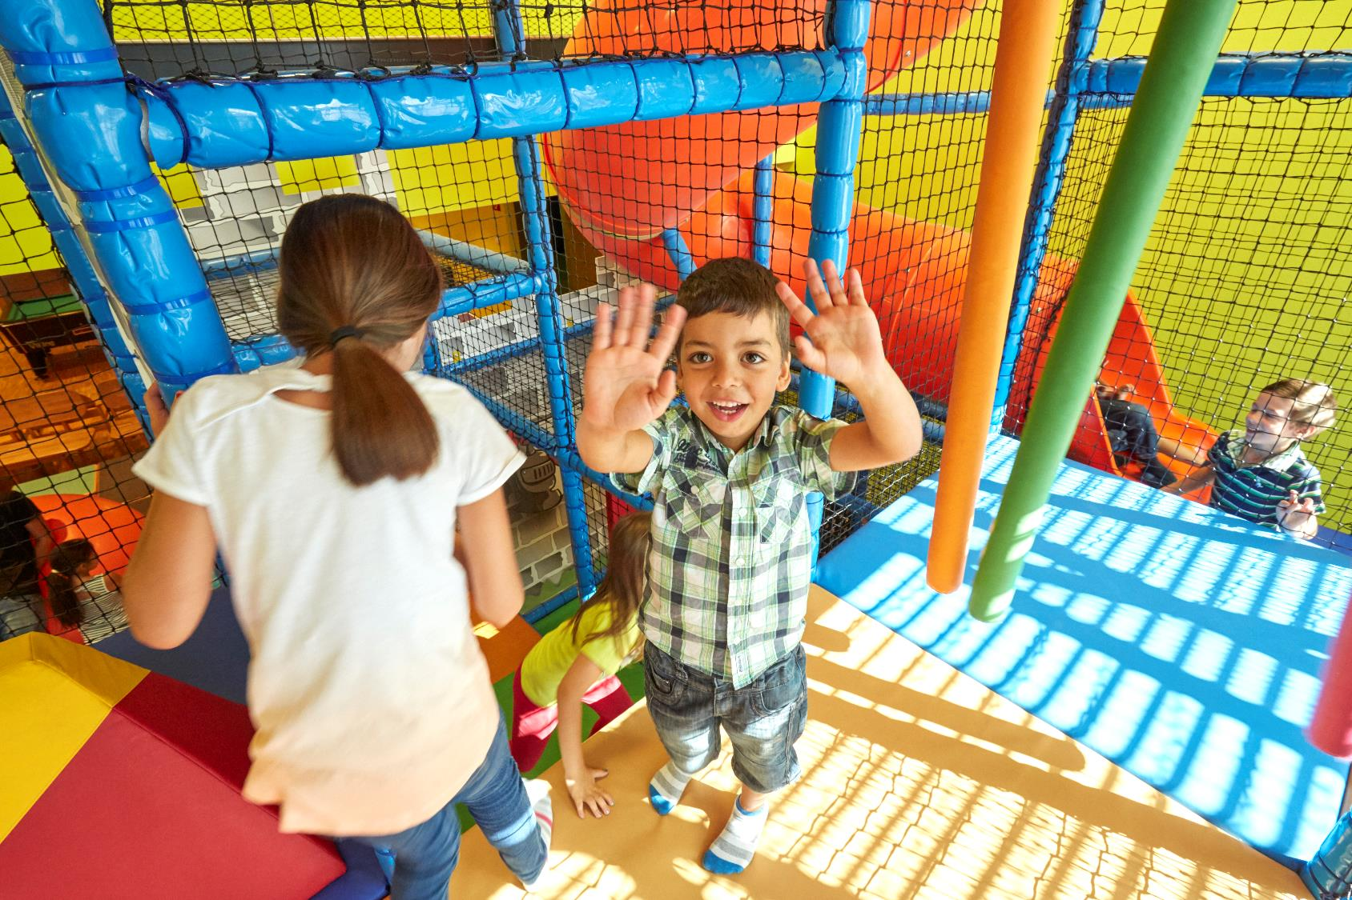
Indoor playground in the Youth Hostel Beaufort
A modern playground with climbing frames, slides and many other varied attractions invites the little guests to have a great time.
Opening hours:
Tuesday till Thursday: 2 PM – 6 PM
Weekends: 11 AM - 8 PM
www.mullerthal.lu
© Christof Weber

Slide 29
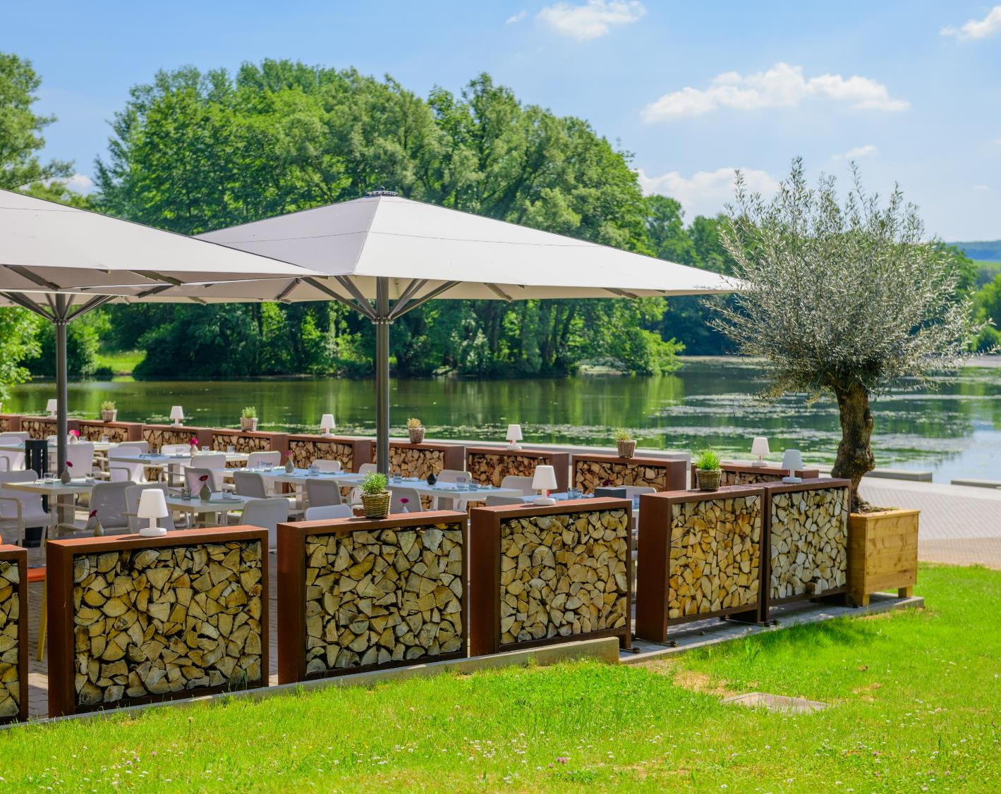
Echternach Lake
Enjoy a sunny day at the lake in Echternach. The lake place offers many opportunities that sporting visitors could possibly desire.
www.visitechternach.lu
© Lakeside

Slide 30
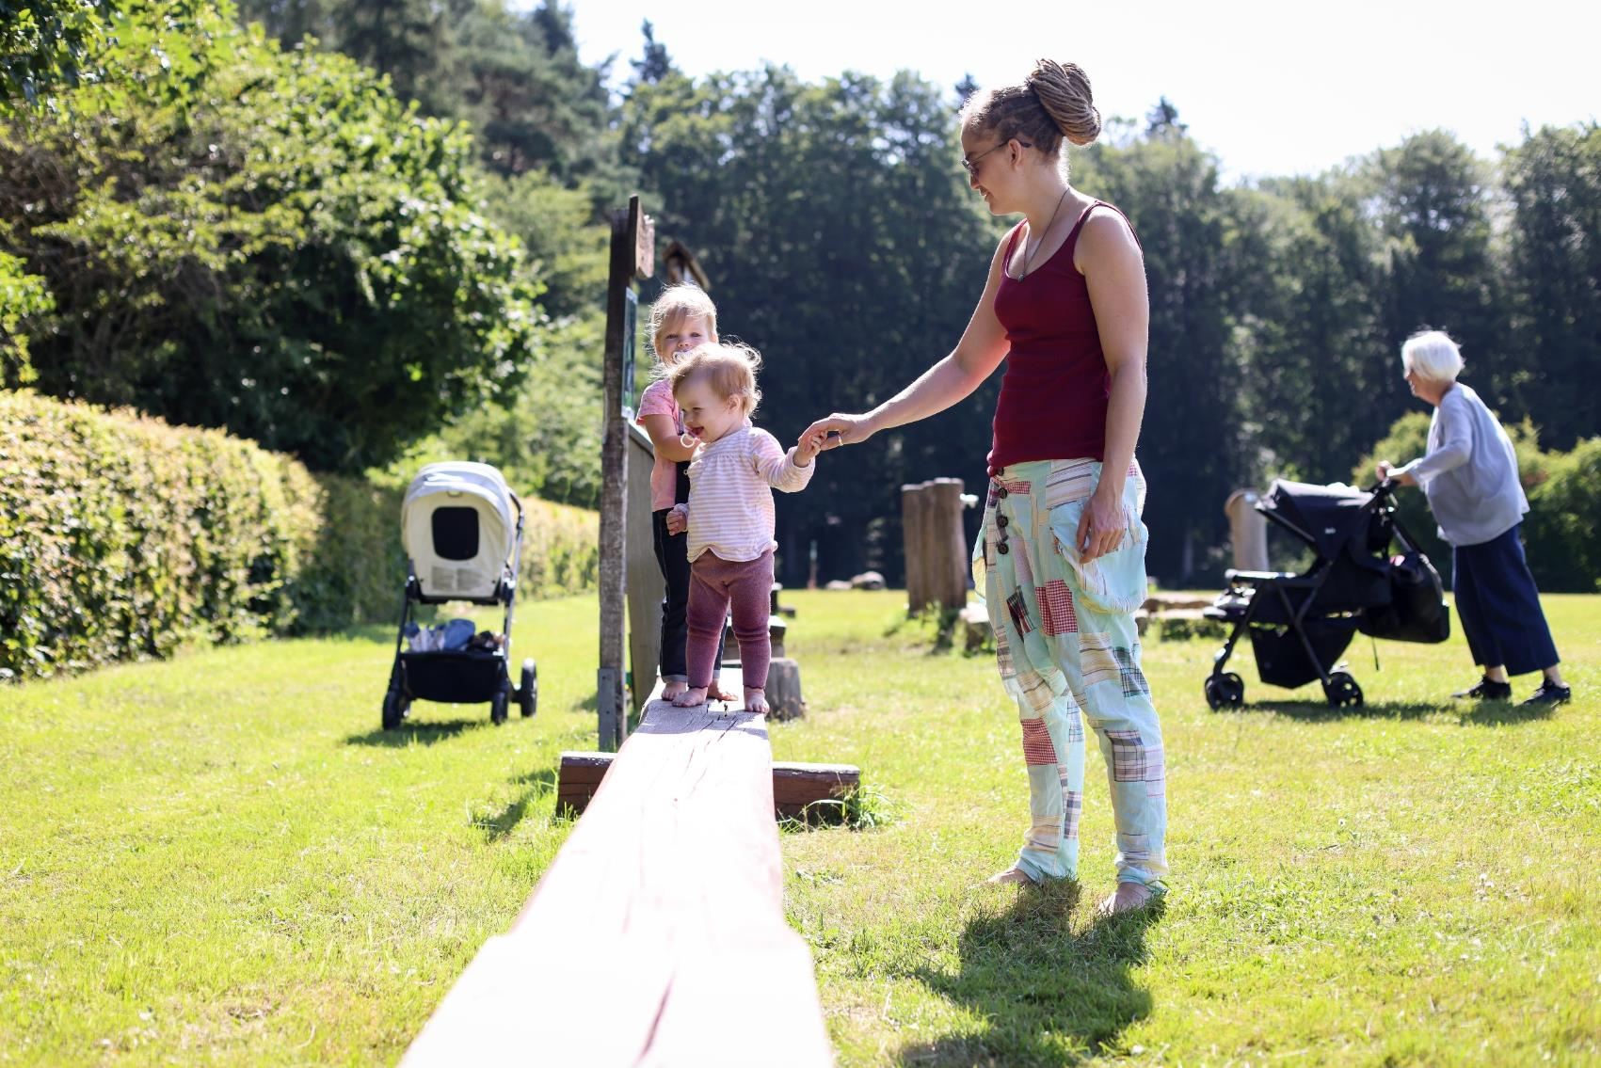
Barefootpath
Take of your shoes and start pure pleasure!
The barefootpath will give you awareness of diferent materials such as barkmulch, sand, stones, etc.
You will find it next to Camping Auf Kengert in Larochette/Medernach
www.mullerthal.lu
© DGT/ Sophie Margue

Slide 31
What‘s on…?
Mullerthal Region - Luxembourg‘s Little Switzerland
Discover many sporting and cultural events taking place in the Mullerthal Region – Luxembourg‘s Little Switzerland!
www.mullerthal.lu
7

Slide 32
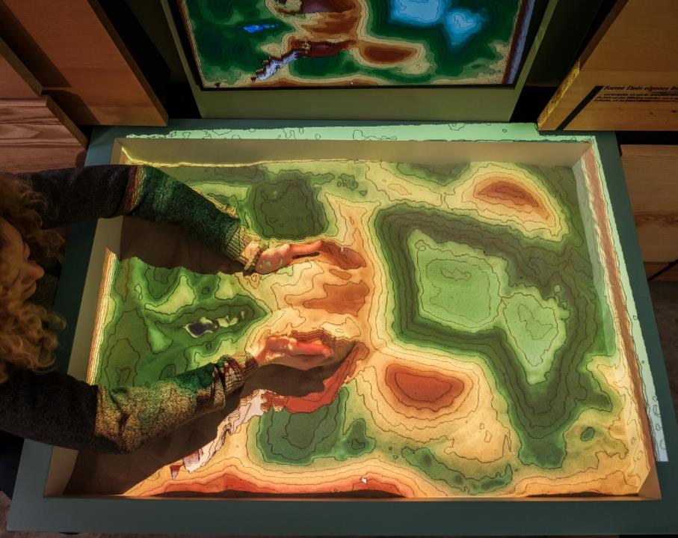
Natur- & Geopark Mëllerdall Exhibition
Visit the exhibition about the genesis of the Mëllerdall landscape and its unique cultural and natural heritage
Opening hours:
Daily: 10 AM – 5 PM
www.naturpark-mellerdall.lu
© Pancake! Photographie

Slide 33
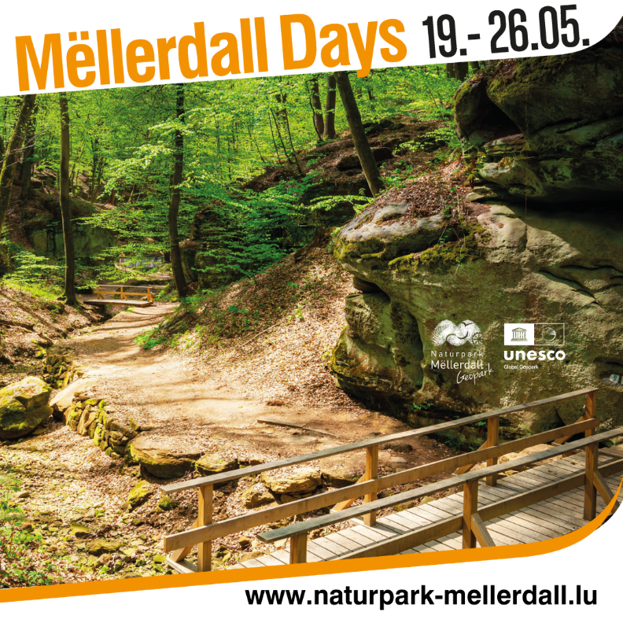
Natur- & Geopark Mëllerdall
Mëllerdall Days
19. - 26.05.
Family rally
Films
Bike tour in the region
Guided hikes
Picnic with regional products
Regional menu in partner restaurants
www.naturpark-mellerdall.lu
© Pancake! Photographie

Slide 34
What‘s on…?
Mullerthal Region - Luxembourg‘s Little Switzerland
Discover many sporting and cultural events taking place in the Mullerthal Region – Luxembourg‘s Little Switzerland!
www.mullerthal.lu
7

Slide 35
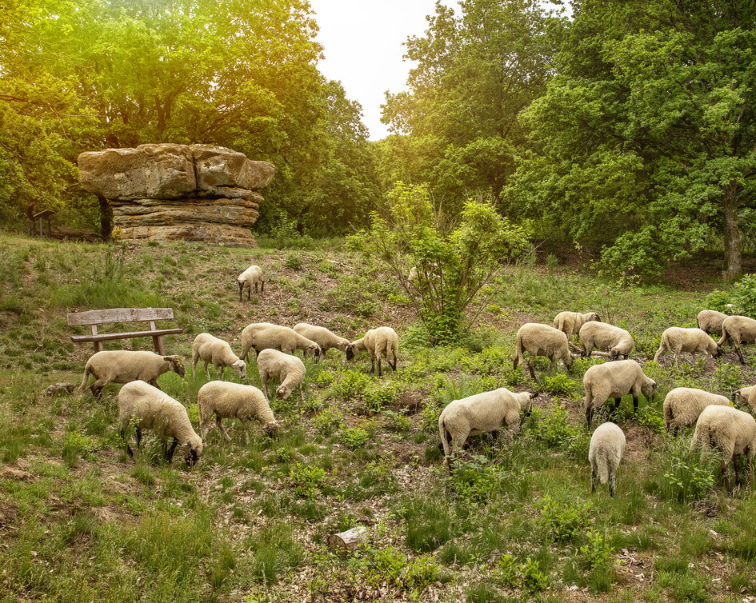
Geosite Champignon
Probably the biggest mushroom in Luxembourg.
Accessible via: Local hiking trail N4 in Nommern
www.mullerthal.lu
© NGPM/photostudioC.Bosseler
Notes:
NGPM/photostudioC.Bosseler

Slide 36
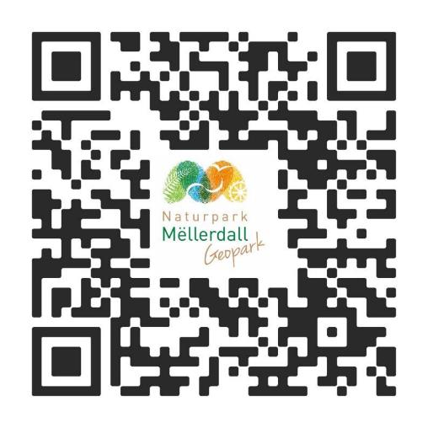
What‘s on…?
Natur- & Geopark Mëllerdall
On a regular basis, the Natur- & Geopark Mëllerdall offers events in the region, on the following topics: forest, wood, water, geology and regional products.
www.naturpark-mellerdall.lu
© Pancake! Photographie

Slide 37
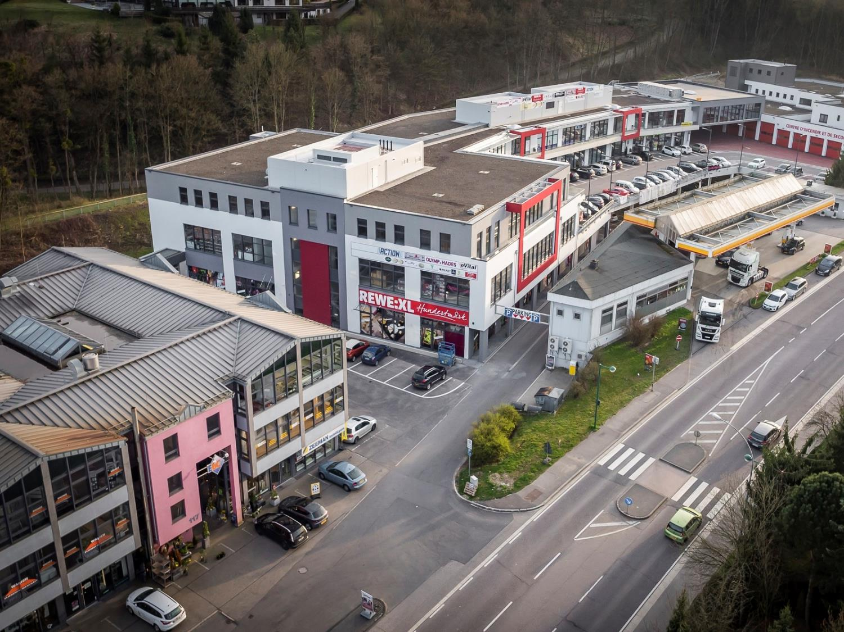
Shopping-Center Nonnemillen
Echternach's Nonnemillen-Center boasts 35+ stores across 17,000 sqm on four floors, complemented by 300 on-site and 550 nearby public parking spaces.
Opening hours: Daily: 8 AM - 8 PM
www.mullerthal.lu
©ORTMPSL
© Nonnemillen Center

Slide 38
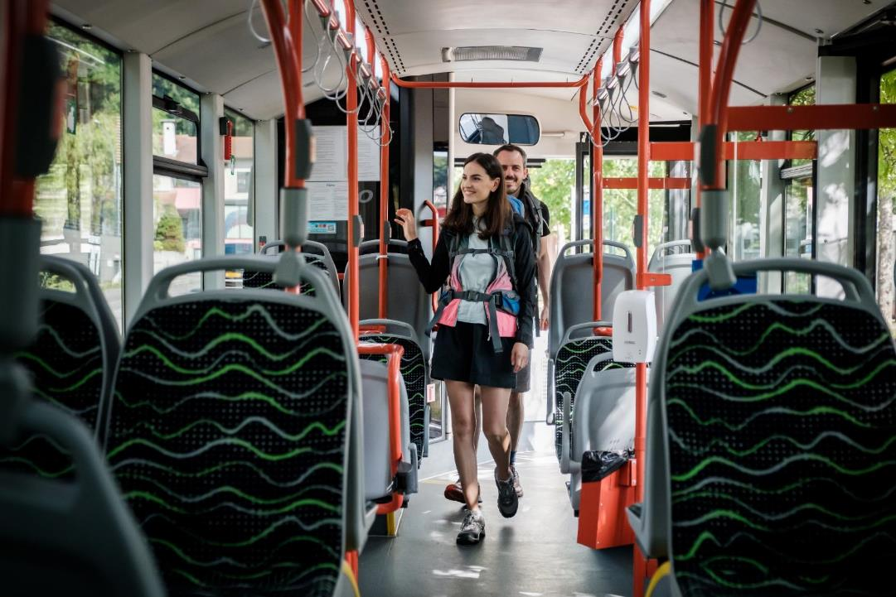
Free public transport
Public transport in Luxembourg is free. So, get in, sit down, relax and enjoy the scenery.
www.mobiliteit.lu
© Pancake! Photographie

